Slide 1
Simulation of intimal thickening in arteries by morphoelasticity
Penn State University
5th February 2019
Pak-Wing Fok
Department of Mathematical Sciences
University of Delaware

Slide 2
Outline of Presentation
Pathophysiology of Atherosclerosis and Glagov Remodeling
Theory of Morphoelasticity
Insights with 1D Model
(Further Applications of 1D Model)
Finite Element Simulation in 2D and 3D
Caveats and Summary
Notes:
PLoS Glagov
Morphoelasticity theory
Lanzer PLoS
2D finite elements
3D finite elements
Question: How does my work differ from current treatments of morphoelasticity?
Understand role of p as a Lagrange multiplier

Slide 3
Pathophysiology of Atherosclerosis and glagov Remodeling

Slide 4
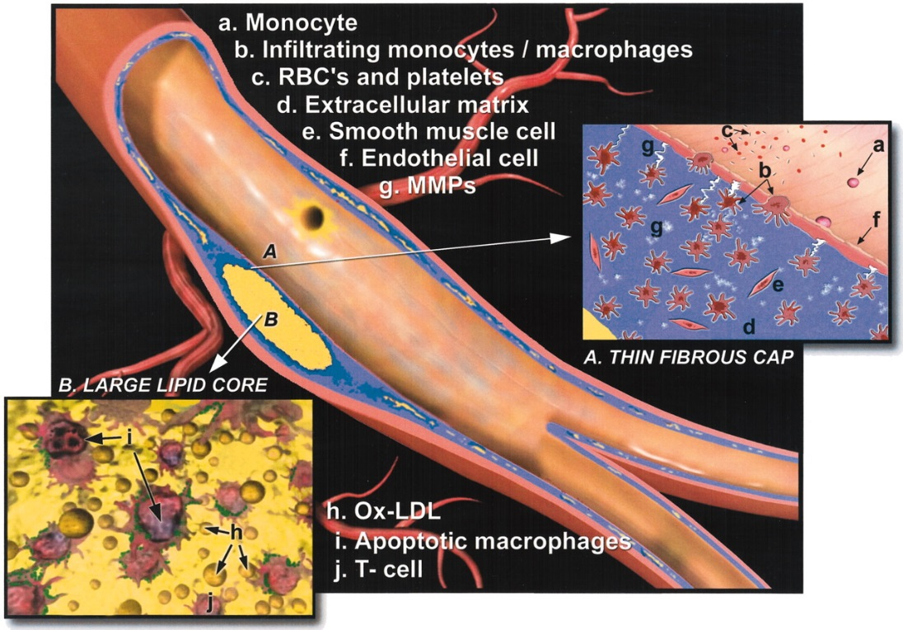
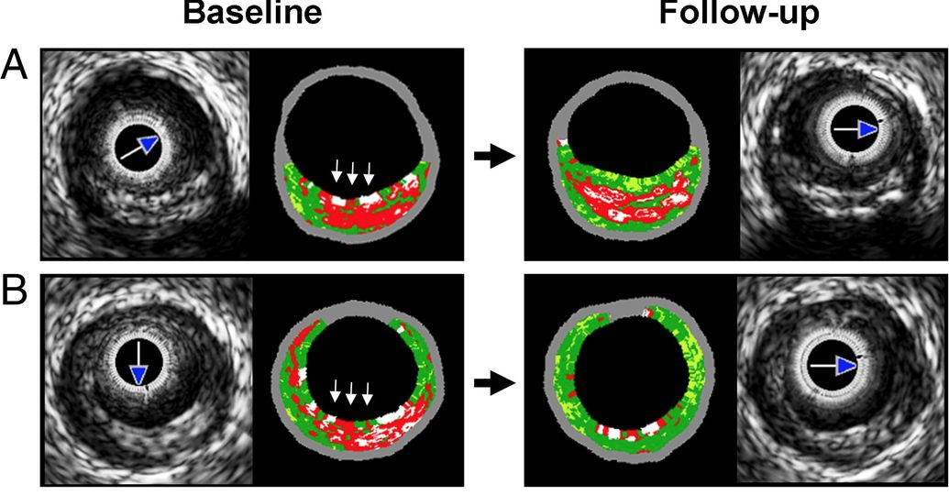
What is atherosclerosis?
Naghavi et al., Circulation (2003)
Atherosclerosis is an inflammatory disease of the arteries, involving cholesterol buildup and accumulations of macrophages and foam cells.
Enhanced ultrasound provides a powerful
tool for understanding disease progression.
From Kubo et al. (2010)
Histological staining and light microscopy is the gold standard for classifying atherosclerotic plaques. (From CVPath Institute)
Notes:
Describe different plaque types.
Describe the pictures from CVPath.
Hypothetical causes of atherosclerosis: LDL, ESS.

Slide 5
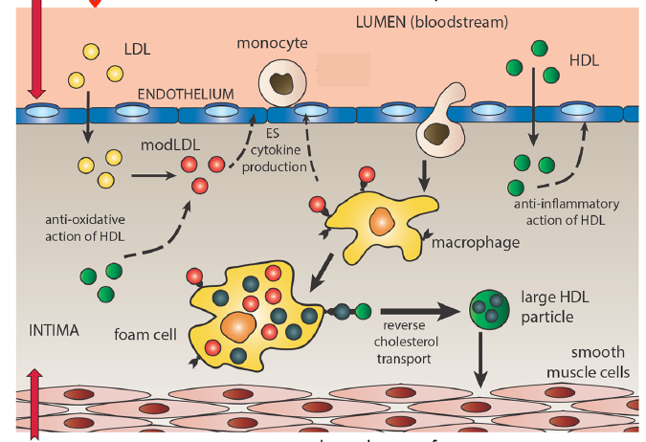
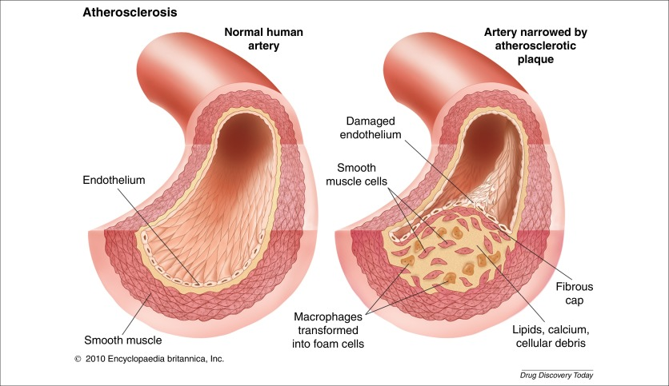
Pathogenesis of Atherosclerosis
From Chalmers et al. (2017)
Main culprits in atherogenesis:
Modified lipoproteins
Low endothelial shear stress
Foam cells
Three layers of an artery wall:
Intima
Media
Adventitia
Notes:
Include OCT and grey scale images too
TCFAs are associated with plaque rupture and heart attacks
A patient’s calcium score is the best indicator of coronary heart disease and all atherosclerotic CVDs combined (Circulation Research 2017)

Slide 6
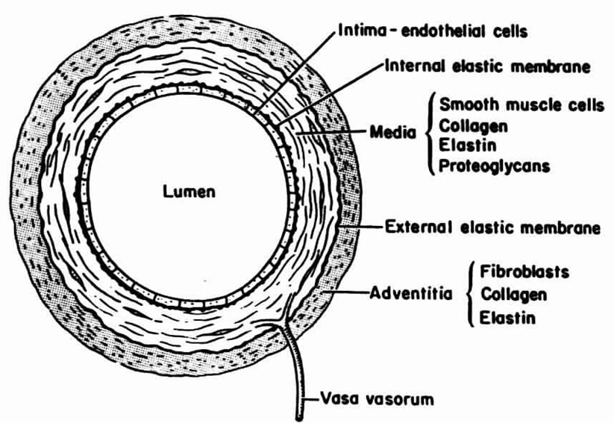
Structure and Organization of Arterial Wall
Remodeling can be hypotrophic, eutrophic or hypertrophic.
Remodeling can be inward, compensated or outward
Institute for Advanced Medical
Education: https://iame.com
An important consequence of atherosclerosis is Vessel Remodeling
Vessel Remodeling is a persistent histological and/or geometric change in the vessel wall
Mulvany, Current Hypertension
Reports (2002)
Notes:
1) How a vessel cross section changes shape can be very complicated. Many different behaviors. In this case, mathematically, it is described by two radii.
2) Lumen size and intima thickness are not necessarily correlated. They are independent variables.
3) “Compensated” is a term we’ll hear often. It’s when the lumen stays the same size under growth.

Slide 7
Atherosclerosis mainly involves thickening/growth of the intima
This usually occurs because of SMC infiltration/proliferation
Question: When the intima expands, what happens to the vessel cross section?

Slide 8
Key Result from Glagov et al. (1987)
Glagov remodeling
in an arterial cross section (NEJM 1987)
Compensating/slight
outward remodeling
Inward remodeling
Histologic sections of the left main coronary artery of 136 hearts were studied. Specimens included without regard to sex, postmortem diagnosis or cause of death.
Notes:
Glagov: Human LCA. First to notice compensatory vs encroachment
Other arteries such as LAD also exhibit GR

Slide 9
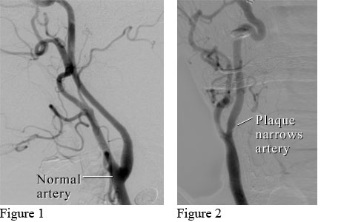
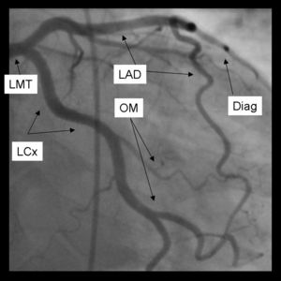
Importance in angiography
“The presence of a nearly normal lumen cross-sectional area despite the presence of a large plaque should be taken into account in evaluating atherosclerotic disease with use of coronary angiography.”
“…plaque size or the extent of involvement of a coronary artery by atherosclerosis may be greatly underestimated when only the lumen is visualized.”
“…the absence of obvious lumen narrowing on angiograms does not necessarily indicate that little or no disease is present.”

Slide 10
Compensatory enlargement: some literature
“Compensatory enlargement of the left main coronary artery: insights from the PROSPECT study” – Inaba et al. (2014)
“Paradoxical increase in lumen size during progression of coronary atherosclerosis: Observations from the REVERSAL trial” – Sipahi et al., Atherosclerosis (2006)
“Impact of Compensatory Enlargement of Atherosclerotic Coronary Arteries on Angiographic Assessment of Coronary Artery Disease” – Stiel et al., Circulation (1989)
“Differential enlargement of artery segments in response to enlarging atherosclerotic plaques” – Zarins et al., Journal of Vascular Surgery (1988)
Notes:
1) Inaba: In vivo study. About 700 US and European patients. IVUS study of patients with vulnerable plaque.
2) Joner & Virmani (editorial): changes in wall composition, cellular interactions, presence of macrophages, MMPs, necrotic core
Enlargement.
3) Korshunov: complicated molecular-scale explanation of Glagov phenomenon. Ligation studies in mice.
4) Problem with all these papers is that they don’t tell us why GR occurs. They say that all these factors (X,Y,Z) are important, but don’t explain why they lead to compensating and then encroaching behavior. Mechanisms for Glagov phenomenon remain mysterious, despite being robustly observed in humans, non-human primates and mice.

Slide 11
Theory of Morphoelasticity
Notes:
Math model vs animal model….

Slide 12
Morphoelasticity: A theory of tissue growth^{1,2}
Morphoelasticity assumption decomposes the deformation gradient into a product of growth and elastic response
1. Goriely and Ben Amar, Biomechanics and modeling in mechanobiology (2007)
2. Goriely and Moulton, New Trends in the Physics And Mechanics of Biological Systems (2011)

Slide 13
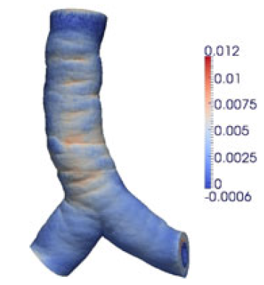
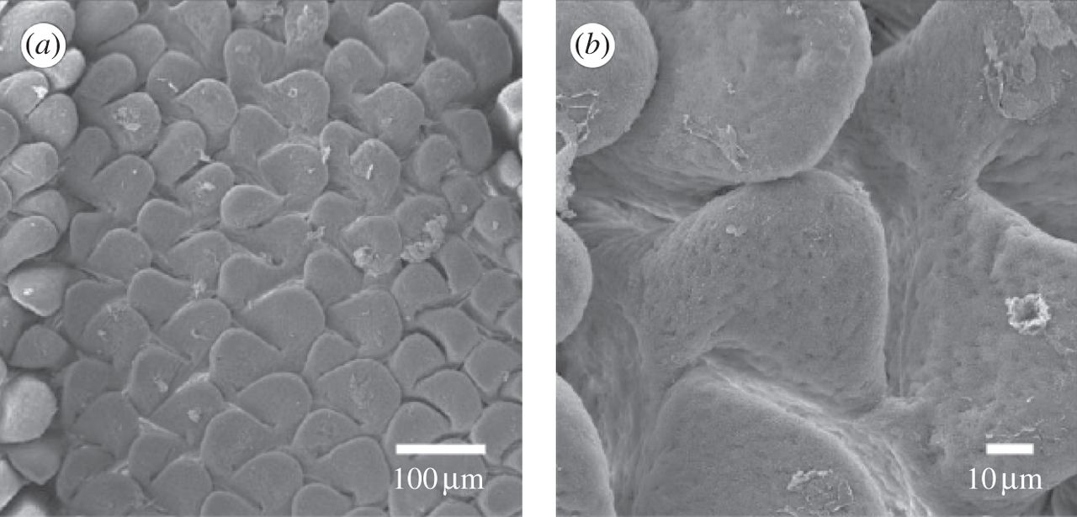
Applications of Morphoelasticity (and related theories)
Dermal wound closure (Bowden et al., (2016))
Arterial wall growth (Kuhl et al., (2006))
Remodeling in aortic arch (Alford and Taber, (2008))
Intestinal villi (Balbi and Ciarletta, (2013))
Tracheal angioedema (Gou and Pence (2016))
FEM simulation of
trachea and bronchi
(Gou and Pence (2016))
Scanning electron micrographs of emerging villi in the jejunum of turkey embryos (Balbi & Ciarletta (2013))

Slide 14
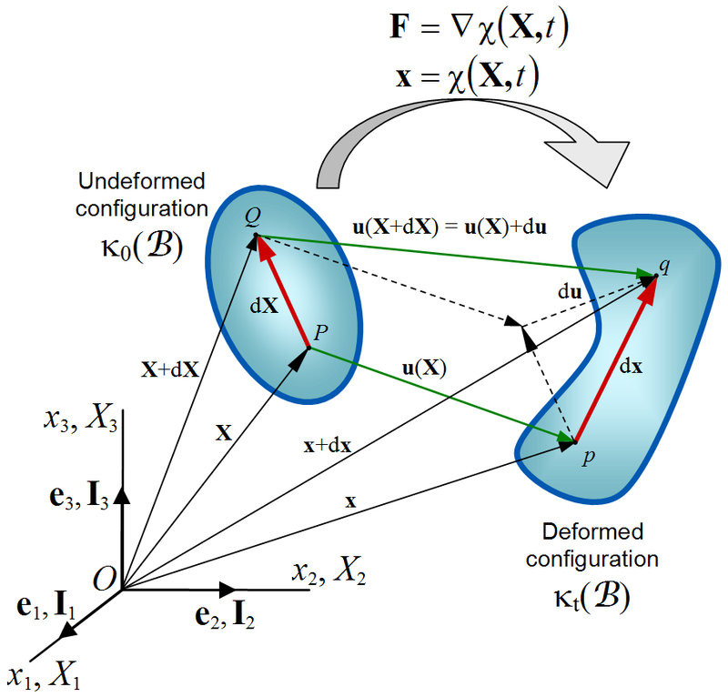
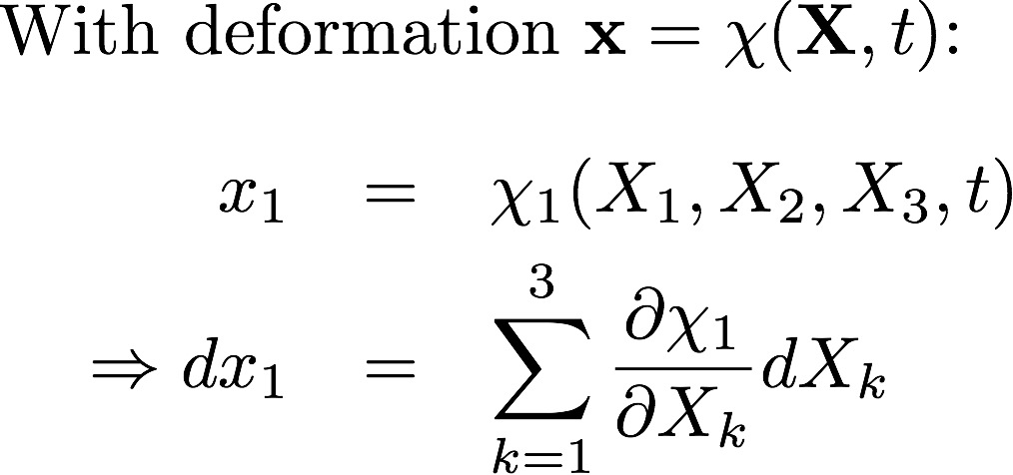
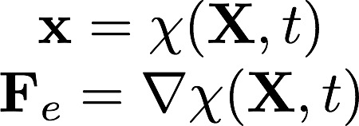
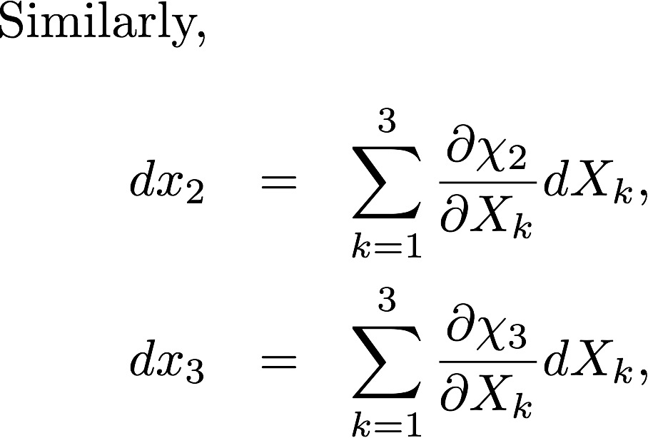
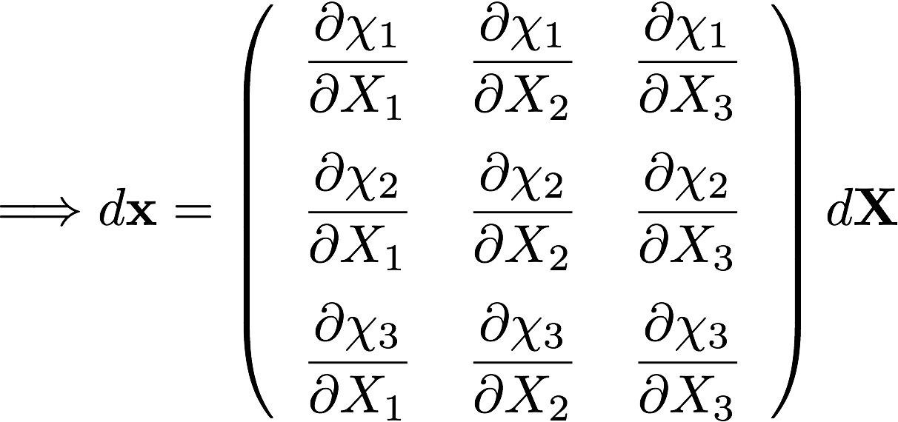

Review of (elastic) deformation
Deformation gradient, F_{e}
Notes:
Deformation gradient F is the Jacobian of the transformation

Slide 15
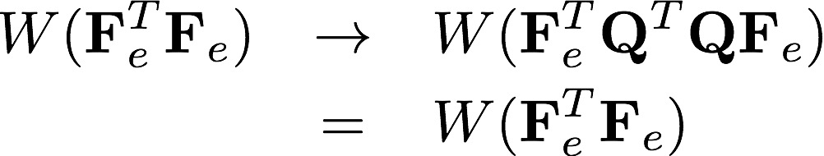
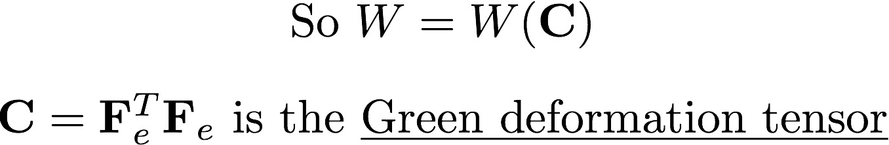
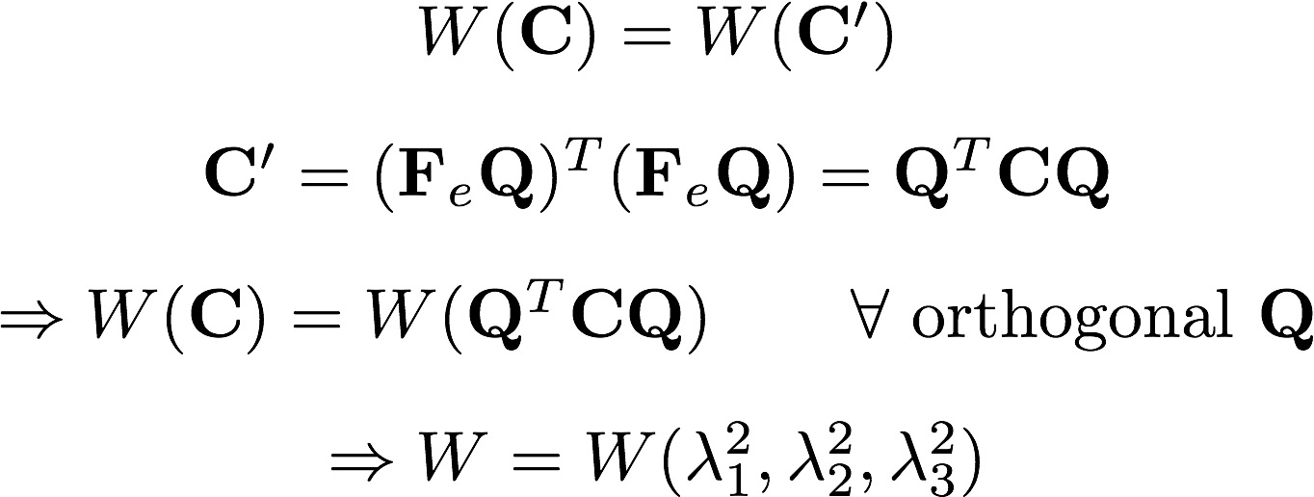

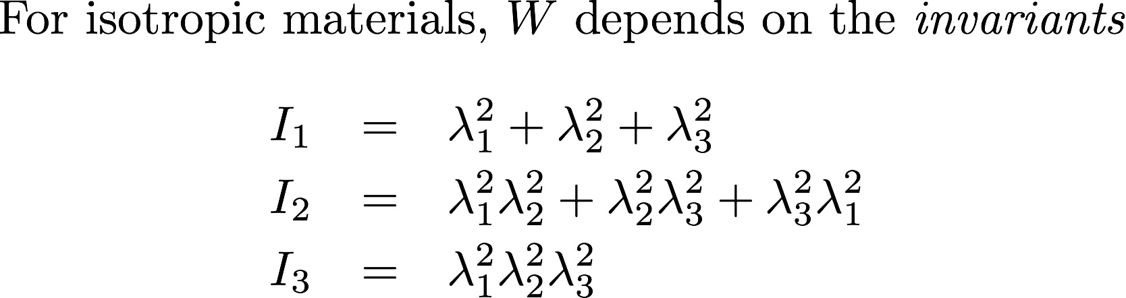
Strain Energy Invariants
Deformed₁
Deformed₂
Reference
F_{e}
Q
Rigid Body
Rotation
Q
F_{e}
Rigid Body
Rotation
Reference₁
Reference₂
Deformed

Slide 16
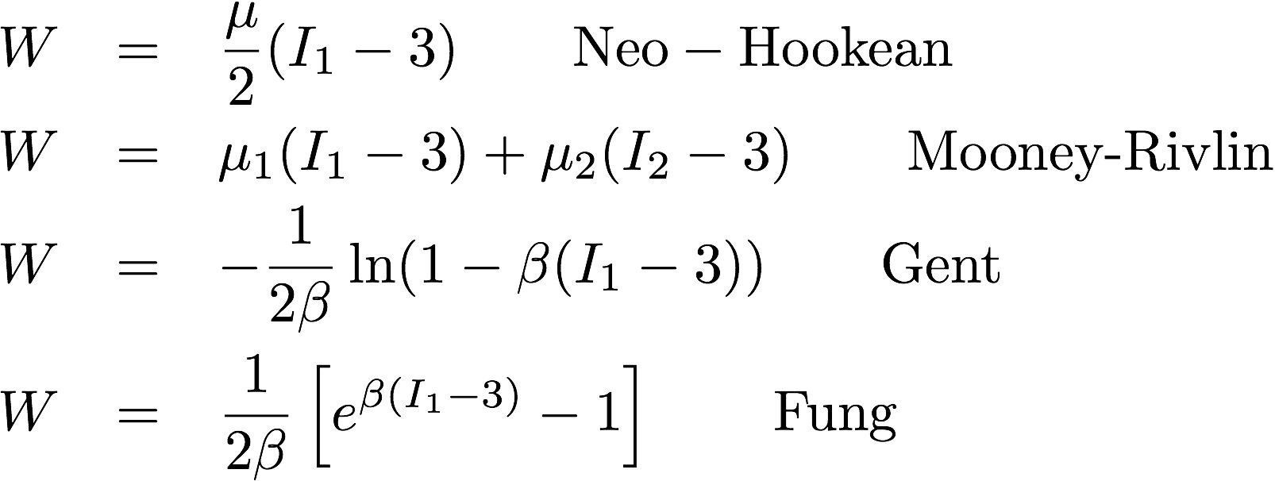
Strain Energies for Isotropic Materials
Different W correspond to materials with different mechanical properties
W can be phenomenological or derived from underlying structure
Parameters may be determined by fitting to stress-strain data sets
Examples:

Slide 17
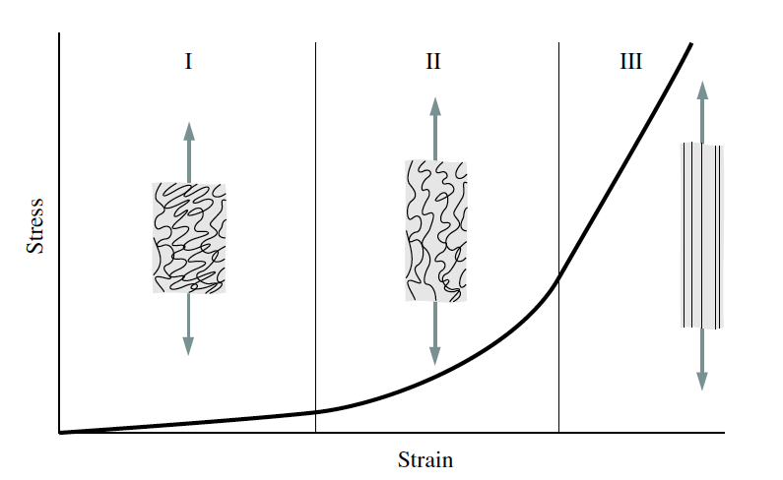
Strain Energy in Arteries
Assume arterial tissue consists of:
isotropic ground substance + anisotropic collagen fibers
I) Tissue behaves like soft isotropic rubber sheet. Response mainly determined by elastin fibers
II) Collagen fibers start to unravel and become load-bearing
III) Collagen fibers are stretched out and strongly resist the load
Taken from “Biomechanics of Soft Tissue”
G. A. Holzapfel (2000)
Notes:
Think of ground substance as ECM, consisting of water, proteoglycans and a random arrangement of elastin fibers
which do not exibit long-range order.
Collagen fibers do exhibit long-range structure.

Slide 18
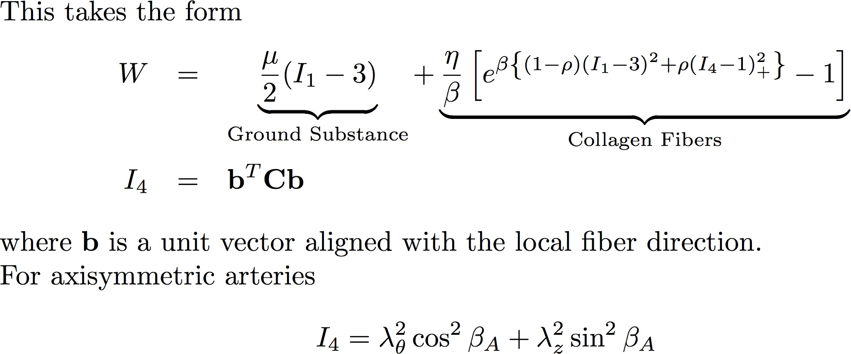
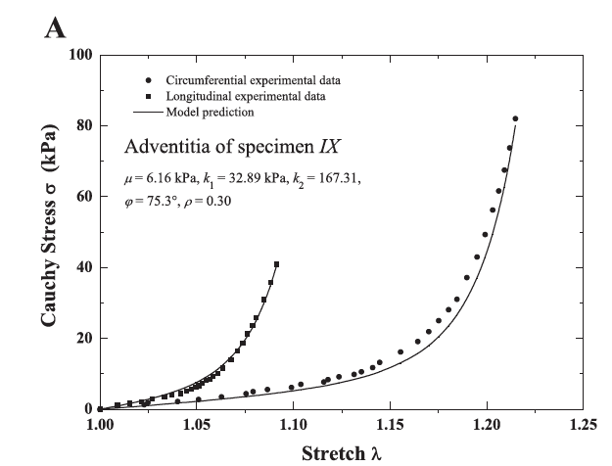
Holzapfel-Gasser-Ogden Strain Energy
From Holzapfel et al. (2005)
From Holzapfel “Biomechanics of
Soft Tissue” (2000)

Slide 19
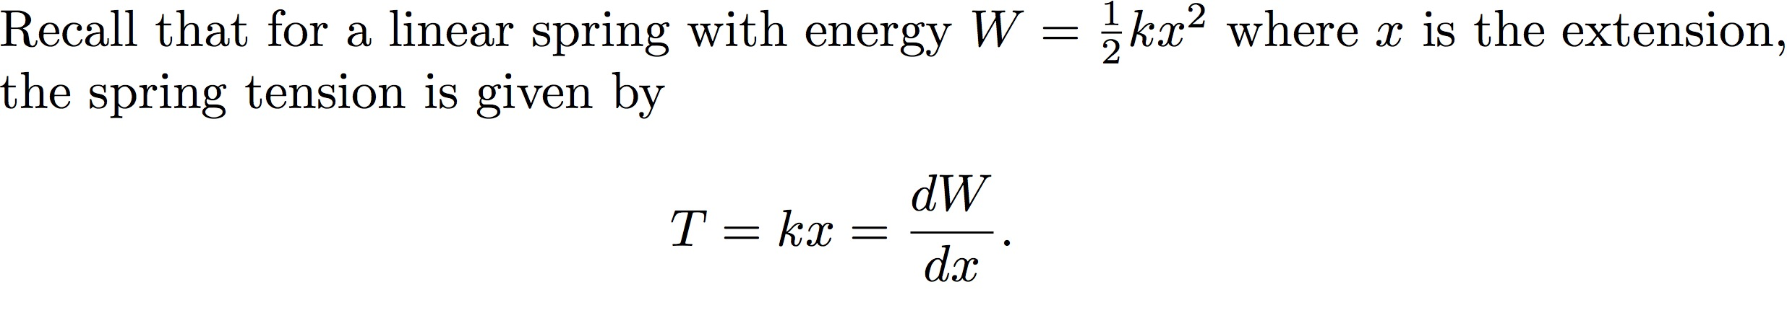
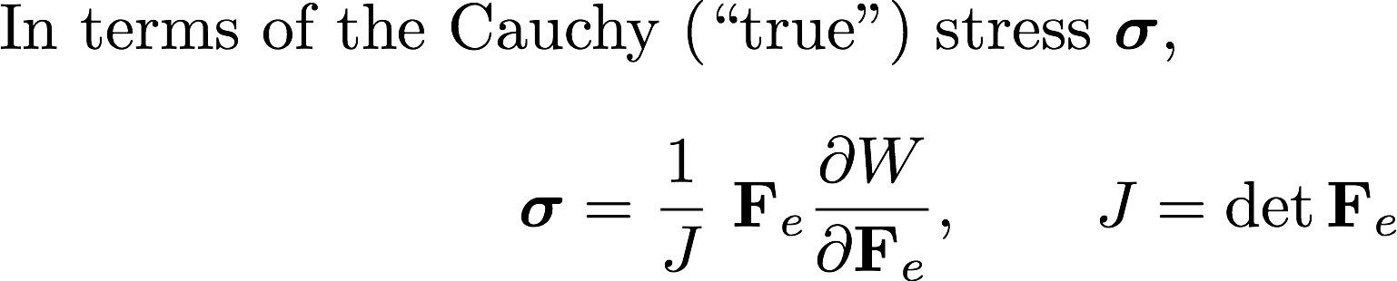
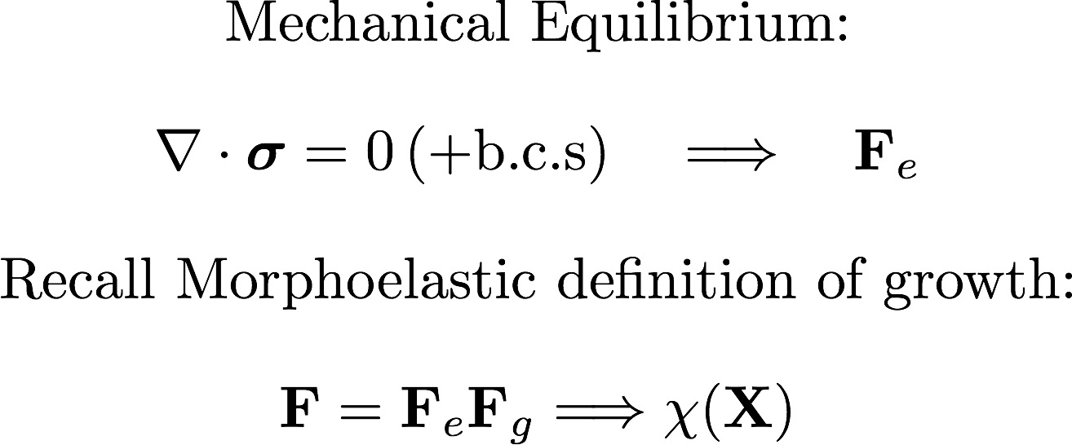
Putting it all together

Slide 20
Insights with 1D model

Slide 21
One-dimensional model of intimal thickening
Axisymmetric for all time: r = r(R,t)
HGO strain energy in media, adventitia
Neo-Hookean strain energy in intima
Isotropic growth: F_{g} = diag(1+t,1+t,1)
Traction-free on outer boundary
Zero lumen pressure P
Conclusions:
Model gives good fit
Critical stenosis predicted at ~20%, not 40% as stipulated by Glagov.
Notes:
A pure mechanical model reproduces glagov’s results.

Slide 22
Difference between data sets^{1,2}
Ex-vivo
In-vivo
This question can be answered in two ways:
Data-driven approach: statistically, is there a difference between in-vivo and ex-vivo remodeling?
Model-driven approach: does the mathematical model predict a difference between in-vivo and ex-vivo remodeling?
¹Fok, PLoS ONE (2016)
²Inaba et al., Coronary Artery Disease (2014)
Notes:
Patients in PROSPECT were older. Few stenoses < 20%
Do the two approaches agree?

Slide 23
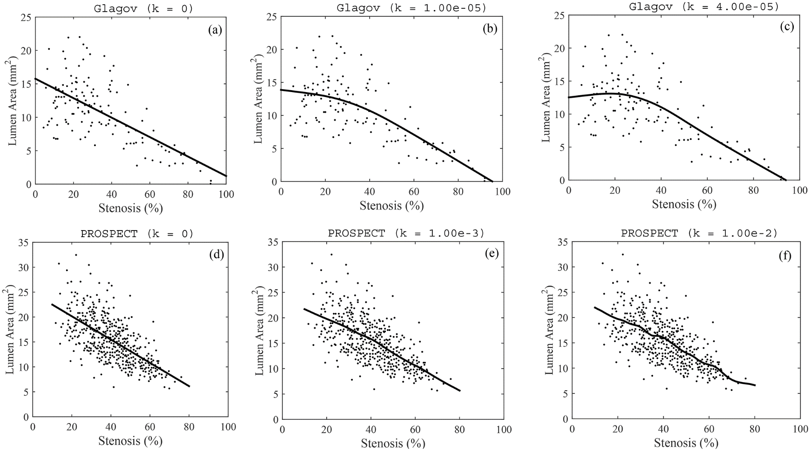
Data Analysis and Curve Fitting
Ex-vivo: possible
Critical stenosis ~13-20%
In-vivo: no evidence of critical stenosis
Notes:
Mathematicians and statisticians have developed a lot of sophisticated curve-fitting techniques
Best fit line is basically linear regression but with a penalty term involving norm of second derivative.

Slide 24
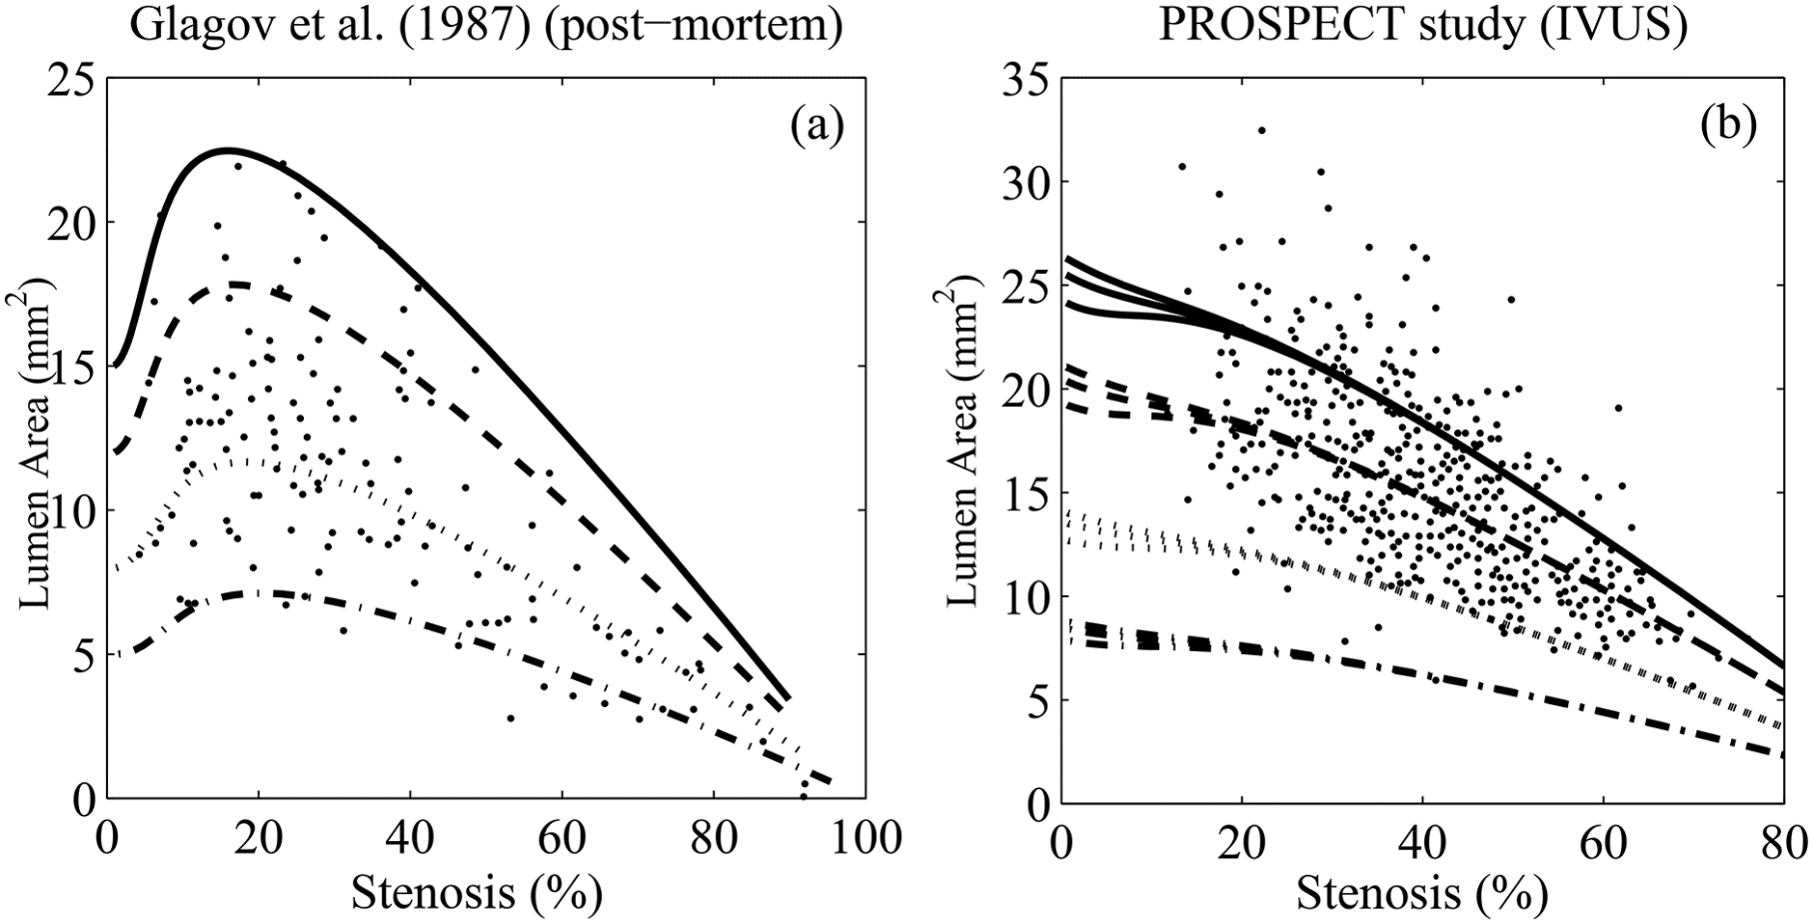
Data Approach is supported by the model
Non-monotonic behavior
Monotonic behavior

Slide 25
Intuitive Explanation for GR
Intima is initially the stiffest layer. Media and Adventitia are relatively compliant
Result: Media and Adventitia yield under growth
Media and Adventitia stiffen as they are deformed
Result: Intima yields
Mathematical Hypothesis: Glagov phenomenon may arise due to competition in stiffnesses among different layers of the vessel wall.

Slide 26
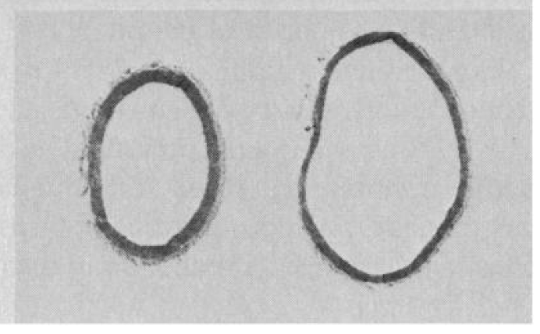
The role of the endothelium as a mechano-sensor
Endothelium can release nitric oxide (a vasodilator) and endothelin 1 (a vasoconstrictor) in response to wall shear stresses (WSS)
Vasodilators and constrictors can change vessel wall radii, maintaining constant WSS under different flow regimes (Langille & O’Donnell (1986), Kamiya & Togawa (1980)).
Encroachment of the lumen could occur when this autoregulatory mechanism breaks down. Media atrophy may play important role.
What is the impact of regulation and mechano-sensing on the mechanical model?
Rabbit carotid arteries before (right) and after (left) flow cessation experiment. From Langille & O’Donnell (1986).

Slide 27
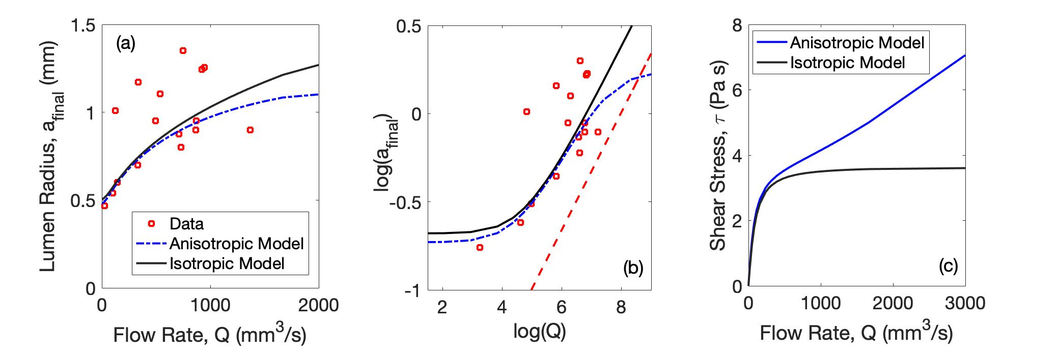
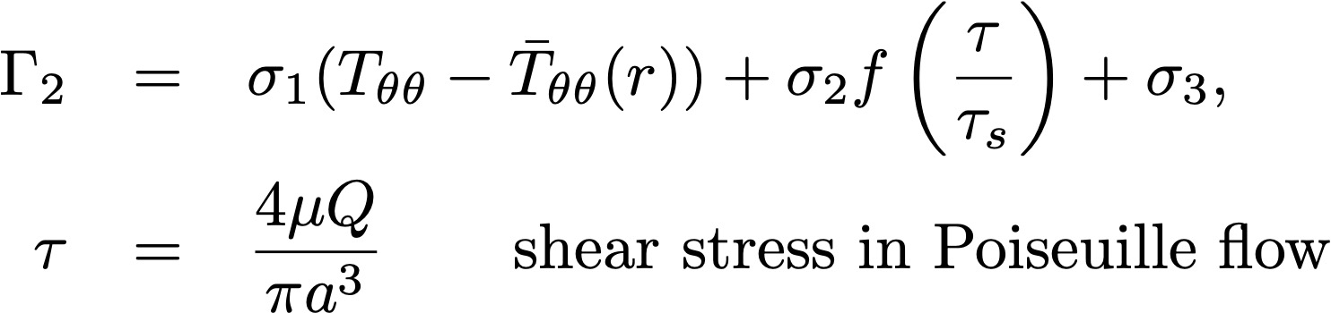
Morphoelastic Model of Vascular Adaptation and Homeostasis
Morphoelastic growth of media depends on PDGF and WSS:

Slide 28
Further applications of 1D model

Slide 29
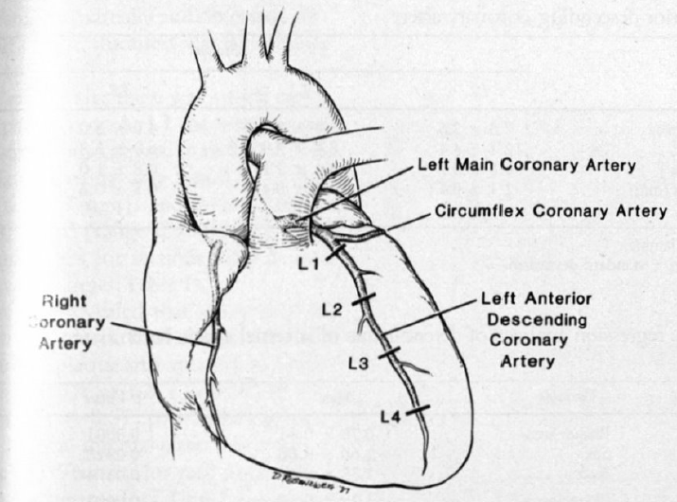
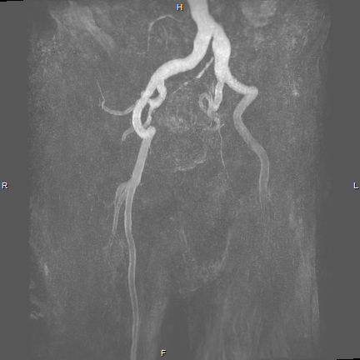
Vessel Size & Remodeling
What is the relationship between vessel geometry and remodeling?
Zarins et al., Journal of
Vascular Surgery (1988)
Fok and Lanzer,
PLoS ONE (2018)
Studied remodeling at four different points along LAD
Tibial arteries remodel more aggressively than femorals
Application to PAD in Type 2 diabetics

Slide 30
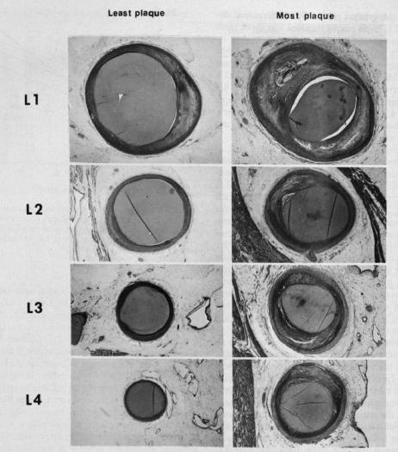
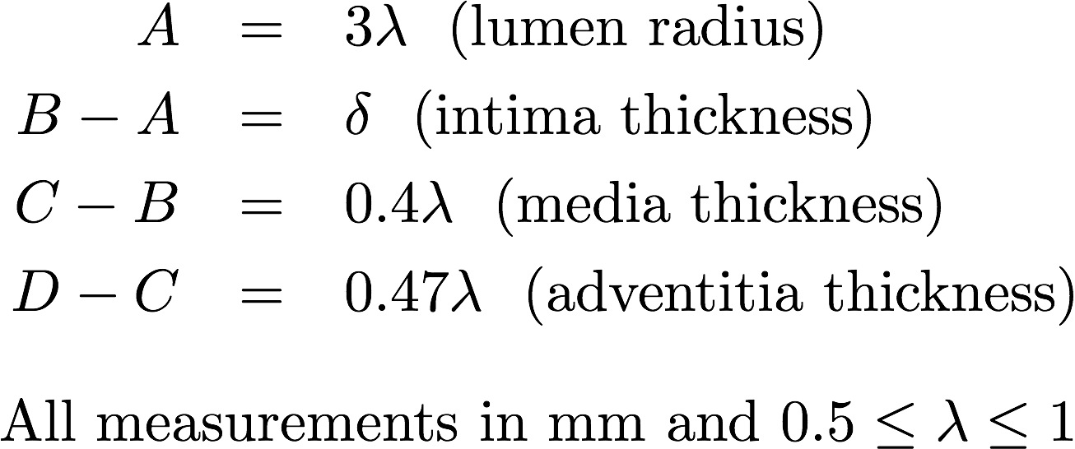
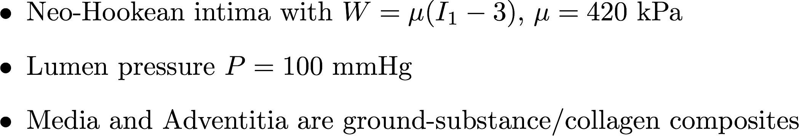
Small arteries tend to compensate more than large arteries

Slide 31
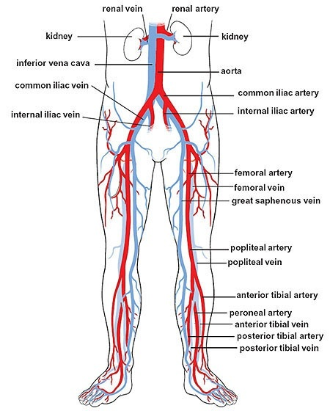
Effect of Media Sclerosis (MS) on Remodeling Rate
MS is a form of atherosclerosis where the media becomes calcified and stiff
Diabetic and non-diabetic patients can suffer from MS
MS is more common (20-30%) in Type 2 diabetics (Elhadd et al. 1999, Hirsch et al. 2001)
The disease is more diffuse/severe in diabetics (Marso et al., JACC (2006))
Diabetic macroangiopathy usually occurs in below-the-knee (BTK) arteries (e.g. tibial) (Jude et al., (2001))
What is the reason for this?

Slide 32
Femoral arteries are located above knee
  Thicker walls; larger lumina
Tibial arteries are located below knee
  Thinner walls; smaller lumina
Simulate media sclerosis by increasing mechanical parameters of media over time
Simulate atherosclerosis by increasing stiffness of intima over time and increasing g
Small tibial arteries tend to inwardly
remodel more aggressively than large femorals

Slide 33
Finite element simulation

Slide 34
General Cross sections and The Finite Element Method (2D)
Deformed
Configuration
Reference
Configuration
Variational Formulation for displacement field:
Notes:
Penalty terms: Note we are using a compressible strain energy function
The coefficients of the penalty terms are not arbitrary – they are chosen so that
The material is physical. For example, the corresponding stress-strain relationship must
Satisfy T=0 when F_e = I

Slide 35
Brief Details of Numerical Method
Mesh generator: distmesh by Per-Olof Persson (Persson & Strang 2004)
Linear basis functions, triangular elements
Single-field displacement-based method (prone to “locking”)
Linear elements; solve for x and y position fields. For N vertices, this constitutes 2N unknowns.
Π is minimized by solving Grad(Π) = 0 using Newton’s Method and QR factorization at each iteration. This is a large, nonlinear algebraic system.
Numerical continuation to evolve in g

Slide 36
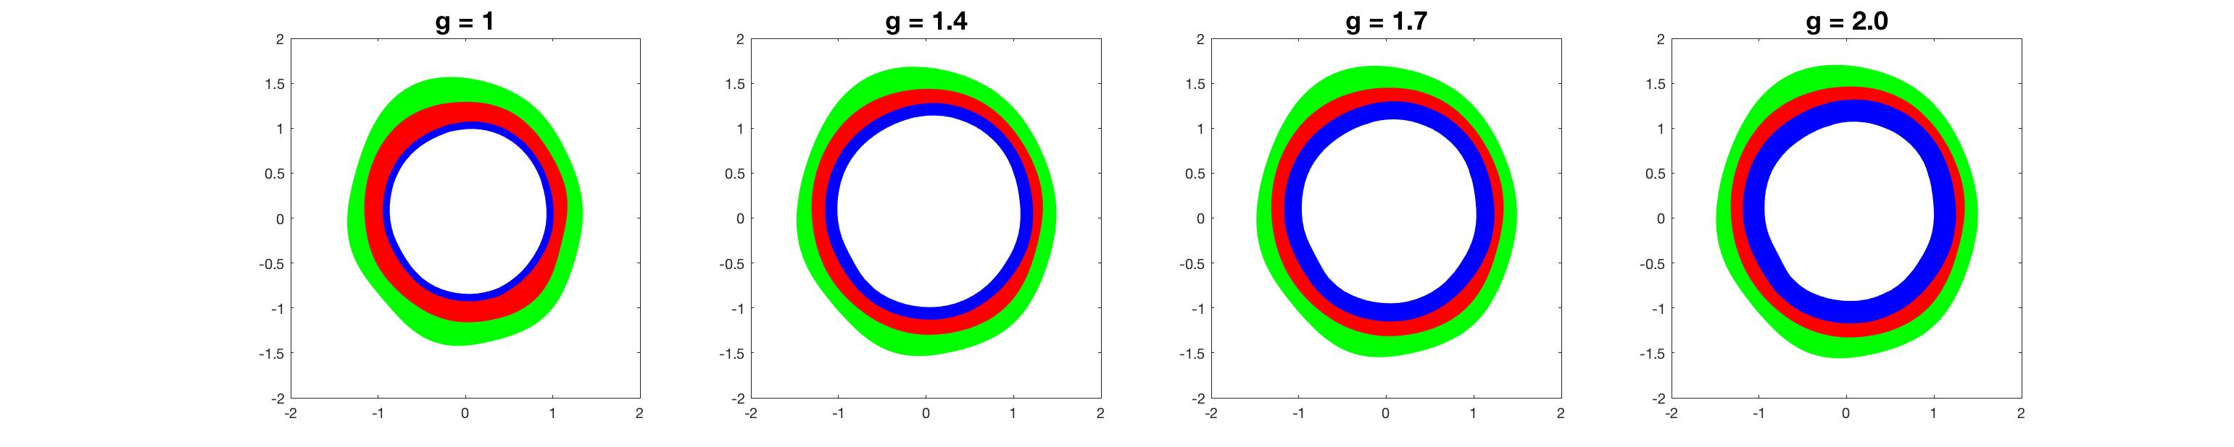
Intimal Thickening in 2D
Comparison of areas with fully incompressible case
Instability of lumen-intima interface wrt small perturbations
Mucosal folding instability (Ciarletta & Amar (2012))

Slide 37
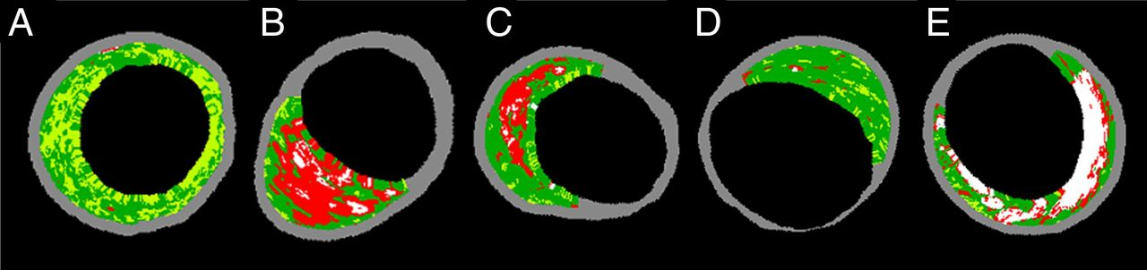
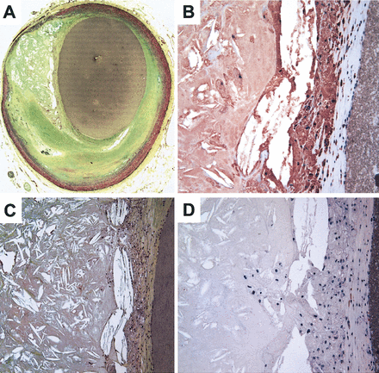
Changes in plaque histology: insights from enhanced IVUS
Plaque classification
73% of myocardial infarctions occur due to rupture of “vulnerable” plaque (Virmani et al., (2000))
Vulnerable plaques are characterized by:
  A large necrotic core
  A thin fibrous cap
  Vasa vasora
  Lack of SMCs
Similarity to cancer tumors
Above: IVUS images from Kubo et al. (2010).
Left: Stained sections from Virmani et al. (2000)
Notes:
Thin cap: < 65 um
Necrotic core and vascularization: similar to cancer tumors

Slide 38
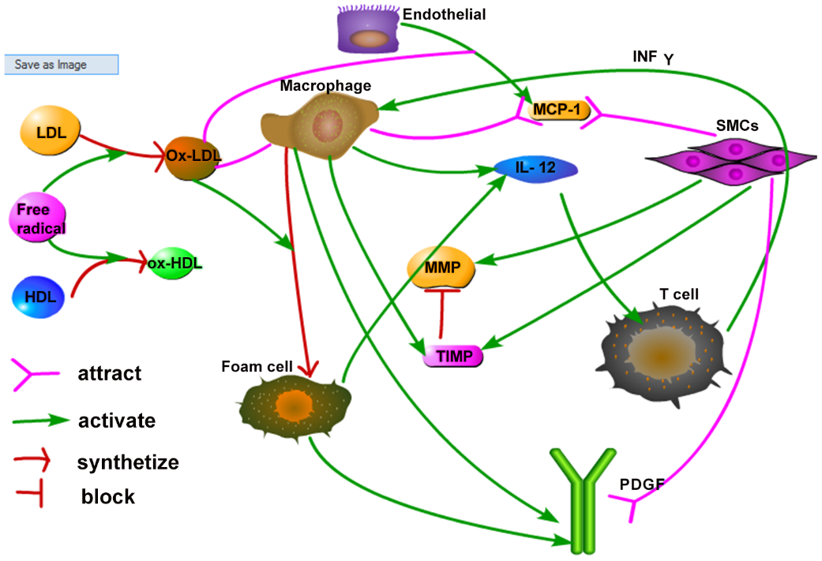

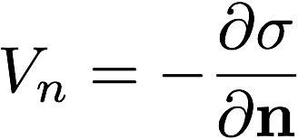
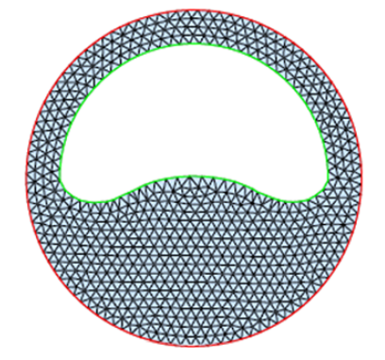
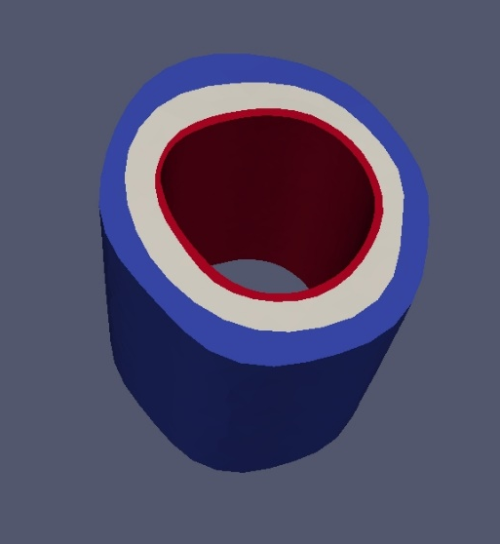
Towards a more realistic model of plaque growth (work in progress)
Hao-Friedman PDEs:
from Hao & Friedman (PLoS ONE, 2014)
Large system of reaction-diffusion equations
Predictions for plaque progression/regression
Intima modeled as porous medium:
Free boundary problem:
Ultimate goals:
Allow PDE variables to depend on local stresses (e.g. WSS-permeability effect)
Allow growth g to depend on local cell numbers/cytokines
Assumption:
Cell and cytokine dynamics evolve much more quickly than growth of vessel: solve steady-state PDEs
Notes:
Plaque tissue undergoes histological changes as it grows.
These changes have been studied by other mathematicians such as
Mary Myerscough (U. Sydney), A. Friedman (Ohio State) and others.
Framework is reaction-diffusion PDEs.
It is fairly straightforward to adopt their approach to a growing domain.

Slide 39
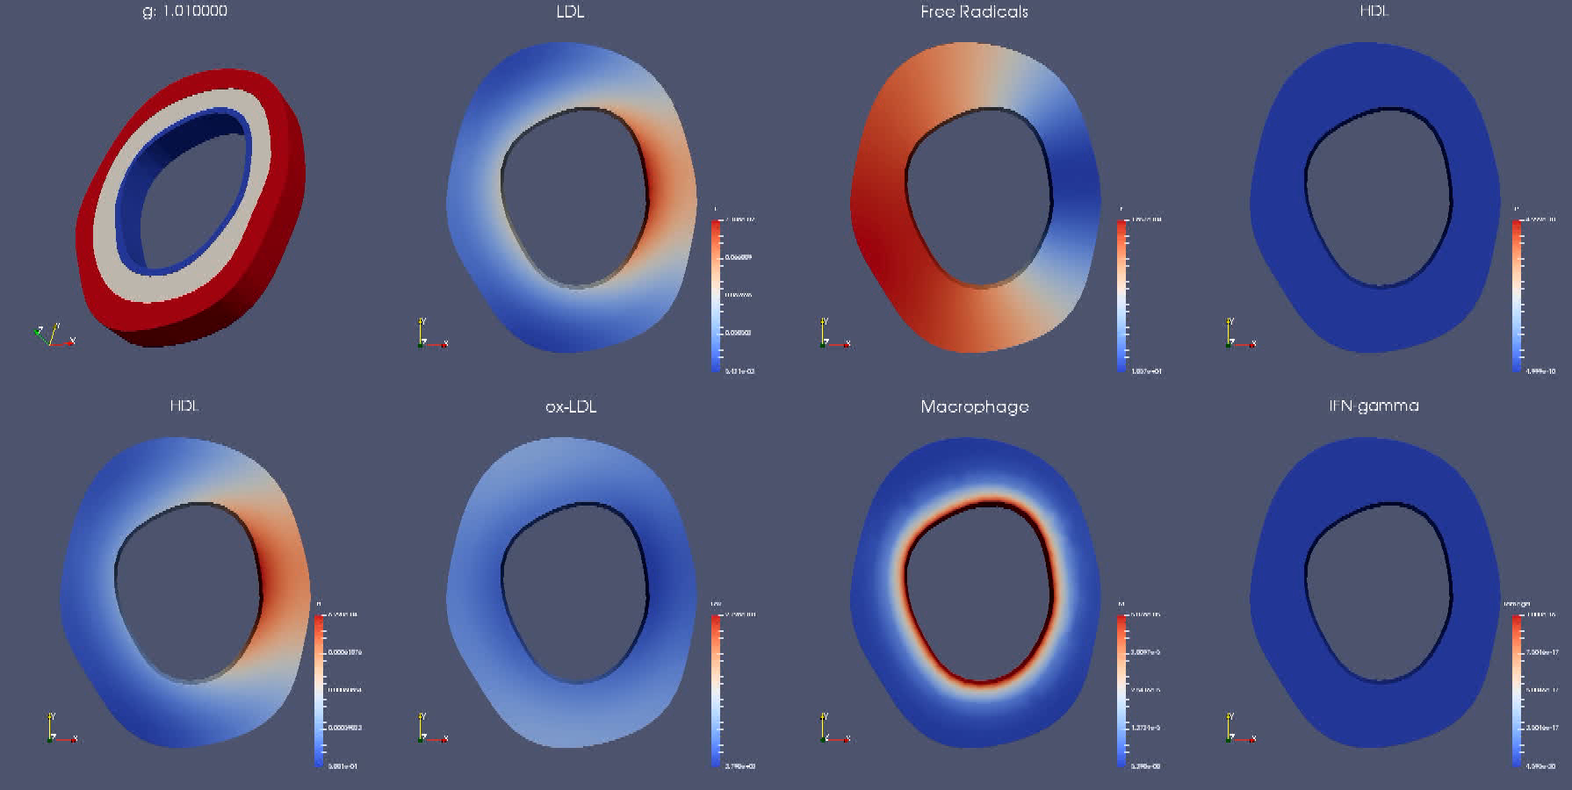
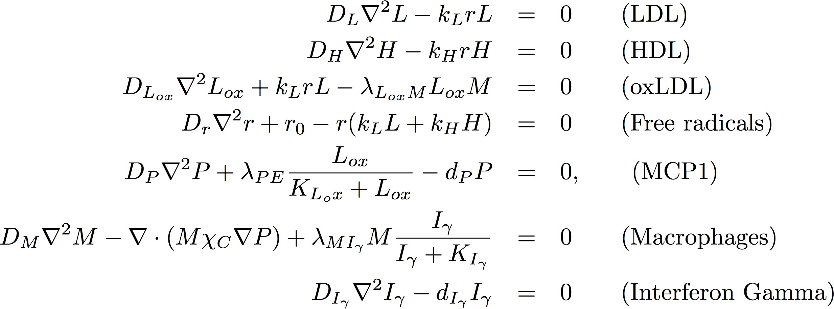
Changes in Histology:

Slide 40
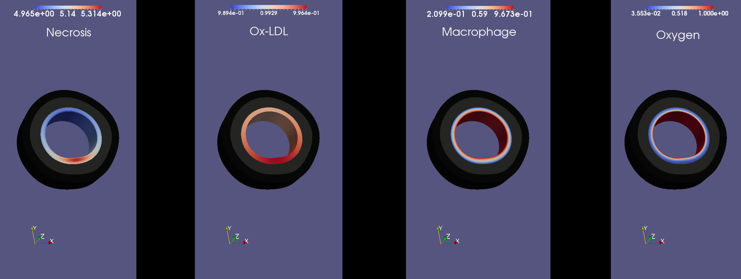
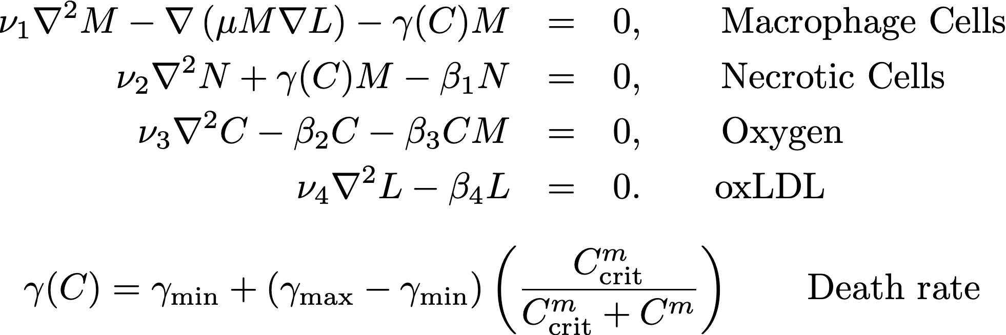
Development of Necrotic Cores:
(PDEs taken from Fok, MMB (2012))

Slide 41
Caveats of Model
Morphoelastic treatment of growth may not be realistic
      More complicated frameworks are found in Ciarletta, Destrade, Gower (2016)
Glagov’s explanation of remodeling is based on artery’s response to wall shear stress, NOT mechanics
Treatment of mechanical properties of intima
  Neo-Hookean vs HGO strain energy
Comparison with enhanced IVUS images
  Discrete categorization of plaque tissue into fibrous/fatty/calcified/necrotic

Slide 42
Summary
Morphoelasticity is a potentially powerful framework for describing atherosclerosis in arteries
1D, 2D and 3D models can all predict compensatory enlargement
Histological changes can be “piggy-backed” onto Morphoelastic framework
Full coupling of growth and histology is a work in progress

Slide 43
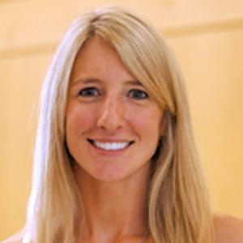
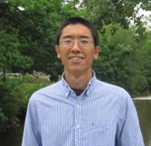
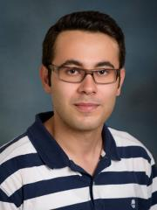

Acknowledgements
Simons Foundation: Travel Grant 282579
Delaware CTR/ACCEL SHoRe Grant (NIH U54 GM104941)
Dr. Rebecca Sanft (U. North Carolina, Asheville)
Dr. Kun Gou (Texas A&M, San Antonio)
Navid Mirzaei (PhD student at UD)

